Slide 1
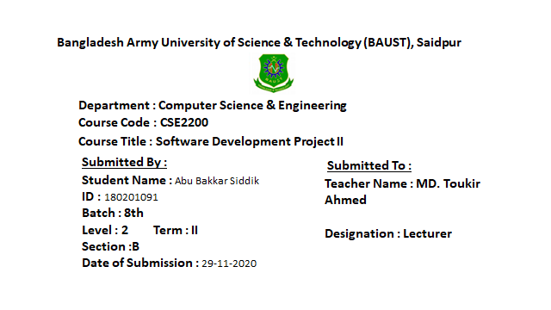

Slide 2

My Project Name
MCQ CONTEST

Slide 3
Outline:
Title
Project Name
Introduction
Problem definition
Output image
Objective
Summary and Conclusion
Reference
Future inhancement

Slide 4
Introduction:
My project name is Mcq Contest. Mcq Contest is a C++ application that has Computer language related question. It has multiple choice questions, true false, gap etc, and it also calculate score of each correct answer. It is good for students of every age group, it helps in increasing general knowledge about computer language, Technology etc. Don’t need register simply give specific user name and password, if you want to login again you can login same password and username. MCQ contest is a think where the programmer ask some question and participant tries to solve them. There may be different types of topic such as c, c++, java, python, physics, chemistry, math etc. .I think my project will help in developing talent and make everyone interested in study .

Slide 5
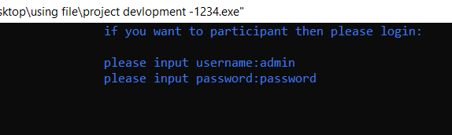
Problem definition:
MCQ Contest is a application developed to conduct an mcq based on time constraints. Mcq contest system is accessed by entering the user name and password which is constant . Question is started by displaying one question with four option each based on computer language and technical knowledge. If the answer is correct score is incremented and no negative mark for wrong answer. when all question are solve then program automatically published final result.
Login system output

Slide 6
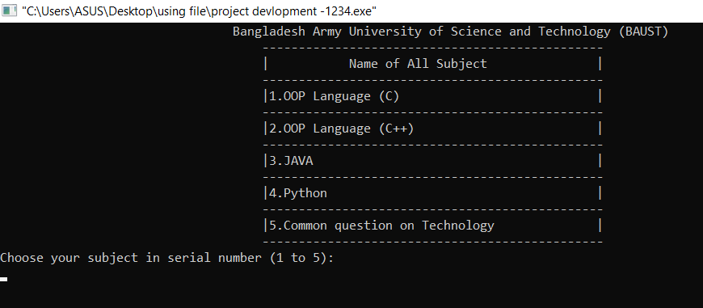
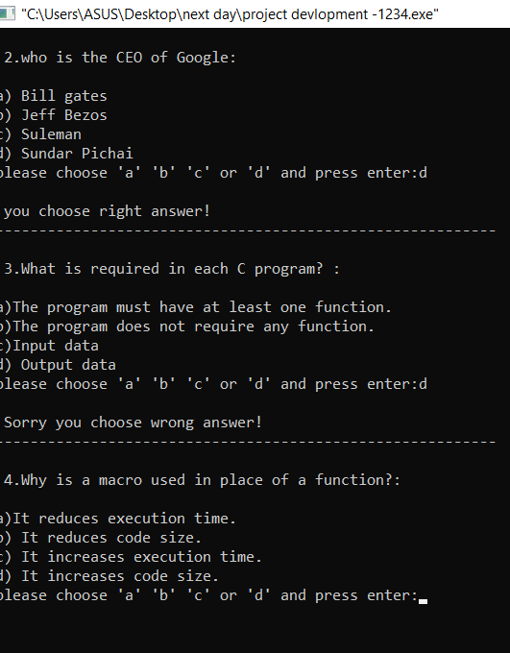
Output image:
Subject menu
Question and answer

Slide 7
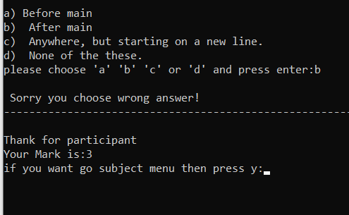
Output image:
Reveal the Result

Slide 8
Objective:
The main objective of mcq Contest is to facilitate a user friendly environment for all user and reduce the manual effort. In past days mcq in conducted manually but in further resolution of the technology we ware able to generate the score. The functional requirements include to create users that are going to participate in the question paper and automatic score generation

Slide 9
Conclusion:
My project will play an effective role in this situation .It is more helpful for the students of every age group. Students of all classes to participant here .There will be a separate question paper for each department .I think my project will help in developing talent and make everyone interested in study.

Slide 10
Reference:
We use C++ programming language. And we use Codeblocks, which is open source IDE for writing this project in C++.
Complete Reference of c++
Teach Yourself C++ Herbert Schildt
https://www.tutorialspoint.com/
https://www.geeksforgeeks.org/
www.Google.com
And my past experience

Slide 11
Future Enhancements:
This is simple offline mcq contest project. I want to work more with this concept in the future. In this project I have used c++ language but in future I want to do this project by android which look like online quiz or Google form, I could but in this situation I didn’t have so much source.

Slide 12
Please visit my project in Github account, Click here
Thank You

